Slide 1
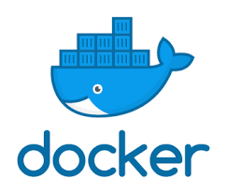

MLOps (Applied Data Science) Topic – Docker
Image source: https://www.docker.com/
Dr. Nilay Karade
Academic Program Manager

Slide 2
Agenda
Why Docker ?
Dependency issues
Virtual machine
What is Docker ?
Docker installation
Docker commands
Docker image
Docker container
Docker hub
Docker file

Slide 3

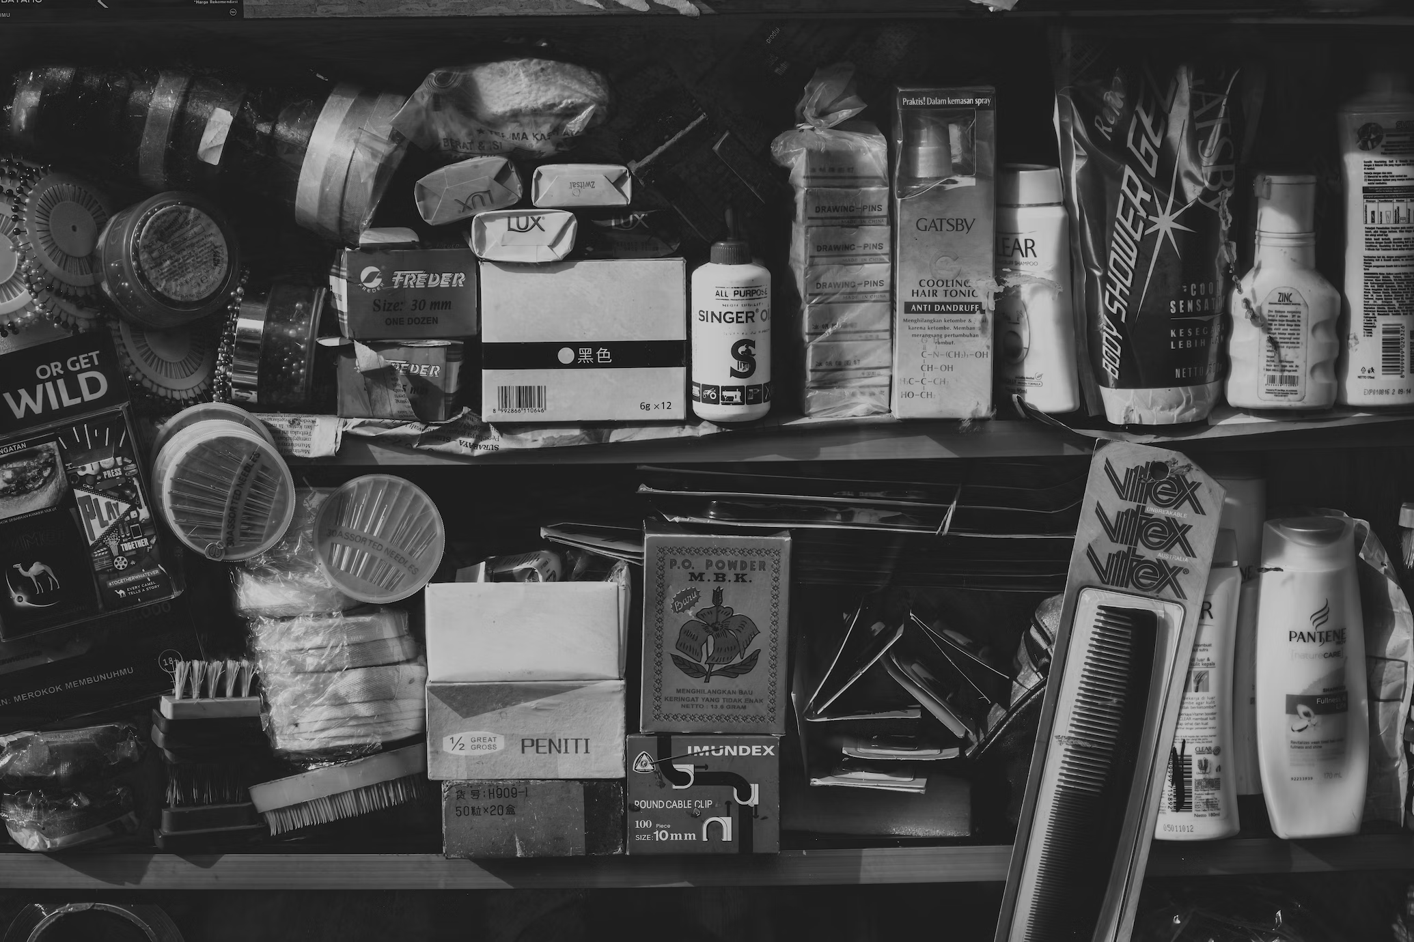
Shifting things

Slide 4
Why Docker ?
Dependency issues
App in local machine
Sklearn 2.0
App in tester / manager / client machine
Sklearn 1.5

Slide 5
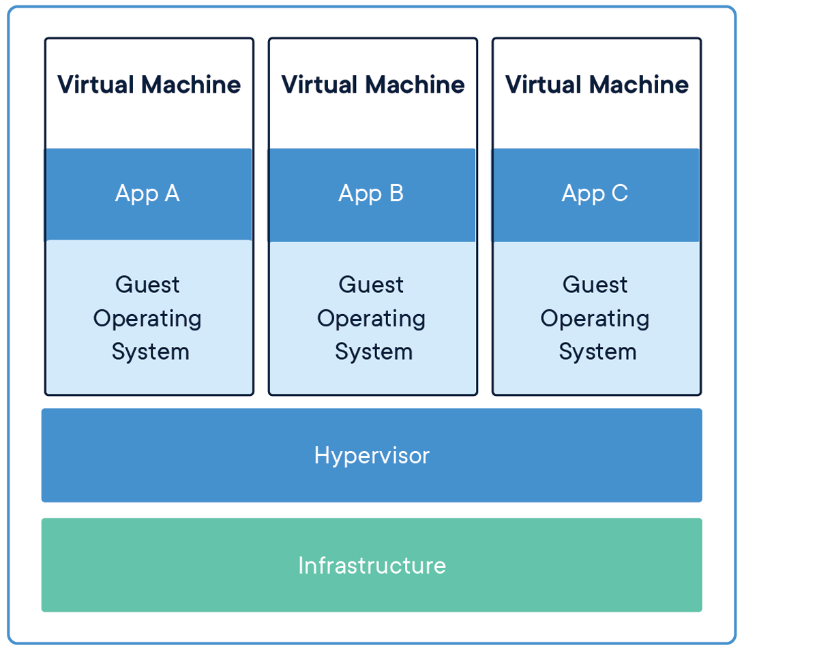
Why Docker ?
Virtual machine
VMs are costly
Can’t install multiple version
of same software/lib
Memory wastage
Image source: https://medium.com/@syed.sohaib/virtual-machines-in-azure-7efdee4df802

Slide 6
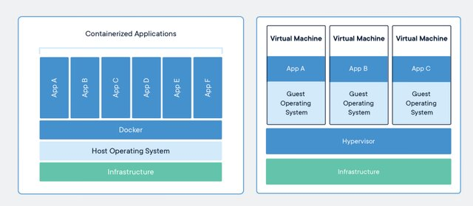
Docker container vs VMs
Image source: https://www.researchgate.net/publication/343764931_Optimizing_Virtual_Resources_Management_Using_Docker_on_Cloud_Applications/figures?lo=1

Slide 7
Docker
Developer
Develops app +
Dockerfile
Docker Image
A blueprint for creating containers.
Docker container
A single instance of the application, that is live and running.
Dockerfile
A text file containing a list of commands to call when creating a Docker Image
Docker hub
Publish container here.
Other Developers
User/developer can use these container to run the app
Notes:
Docker Container: A Docker container is a standalone and executable package that contains an application and its dependencies. Containers are isolated from the host system and from other containers, making them consistent and predictable.
Docker Image: A Docker image is a read-only blueprint for creating Docker containers. Images are used to package and distribute applications. They include the application code, runtime, libraries, and configuration.
Docker Engine: Docker Engine is the core component of Docker. It's responsible for building, running, and managing containers. Docker Engine consists of the Docker daemon (server) and the Docker client (CLI).
Dockerfile: A Dockerfile is a text file that defines the configuration and steps for creating a Docker image. It specifies the base image, installation of dependencies, and the application to run.
Docker Hub: Docker Hub is a cloud-based repository where you can find and share Docker images. It's a central registry for Docker images, and it allows you to access and distribute public and private images.

Slide 8
What is Docker?
Docker is a platform for developing, shipping, and running applications inside containers.
Containers are lightweight and portable environments that include everything needed to run an application, including the code, runtime, libraries, and system tools.
Docker simplifies the process of building, deploying, and managing applications across different environments, from development laptops to production servers.

Slide 9
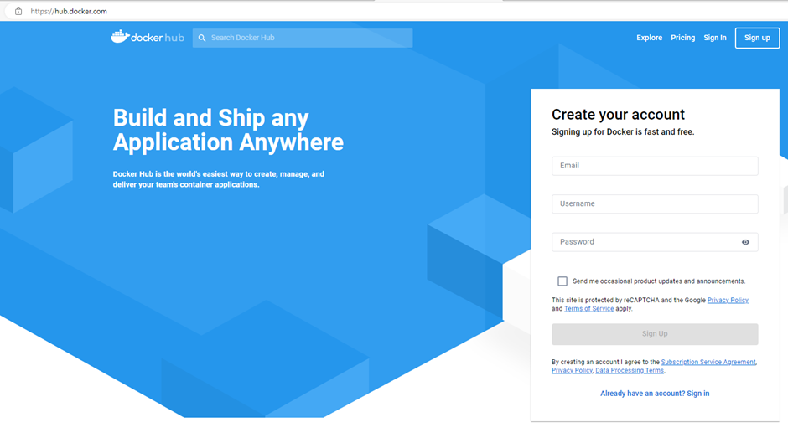
Create an account on https://hub.docker.com

Slide 10
Docker prerequisite
Refer recording or https://medium.com/devops-with-valentine/how-to-install-docker-on-windows-10-11-step-by-step-83074a80e6f9 for prerequisite for Docker
Enable Hyper V
Install wsl from Windows Store

Slide 11
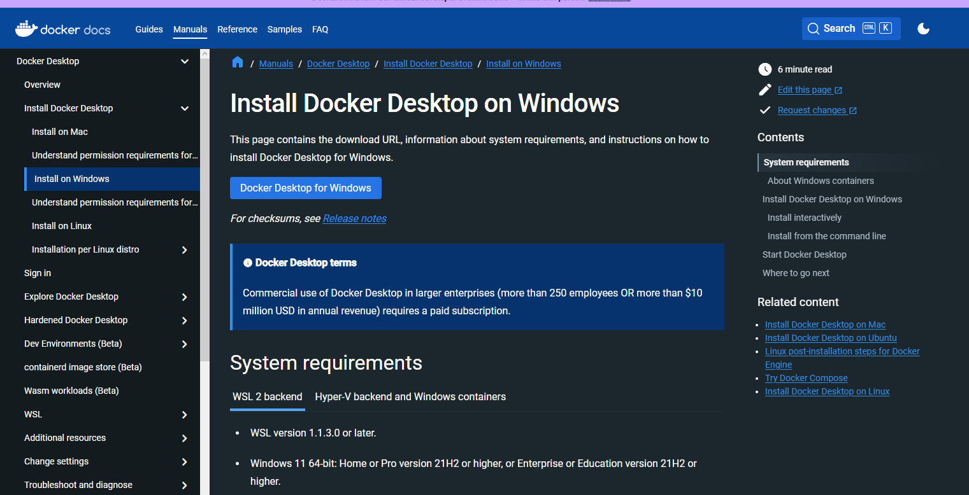
Download docker installer
https://docs.docker.com/desktop/install/windows-install/

Slide 12
Key concepts and components of Docker include:
Docker Container: A Docker container is a standalone and executable package that contains an application and its dependencies. Containers are isolated from the host system and from other containers, making them consistent and predictable.
Docker Image: A Docker image is a read-only blueprint for creating Docker containers. Images are used to package and distribute applications. They include the application code, runtime, libraries, and configuration.
Docker Engine: Docker Engine is the core component of Docker. It's responsible for building, running, and managing containers. Docker Engine consists of the Docker daemon (server) and the Docker client (CLI).
Dockerfile: A Dockerfile is a text file that defines the configuration and steps for creating a Docker image. It specifies the base image, installation of dependencies, and the application to run.
Docker Hub: Docker Hub is a cloud-based repository where you can find and share Docker images. It's a central registry for Docker images, and it allows you to access and distribute public and private images.

Slide 13
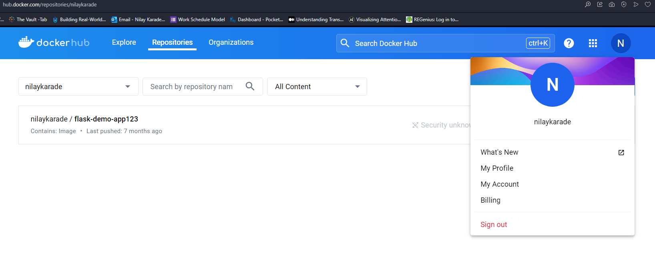
Dockerhub – hub.docker.com

Slide 14
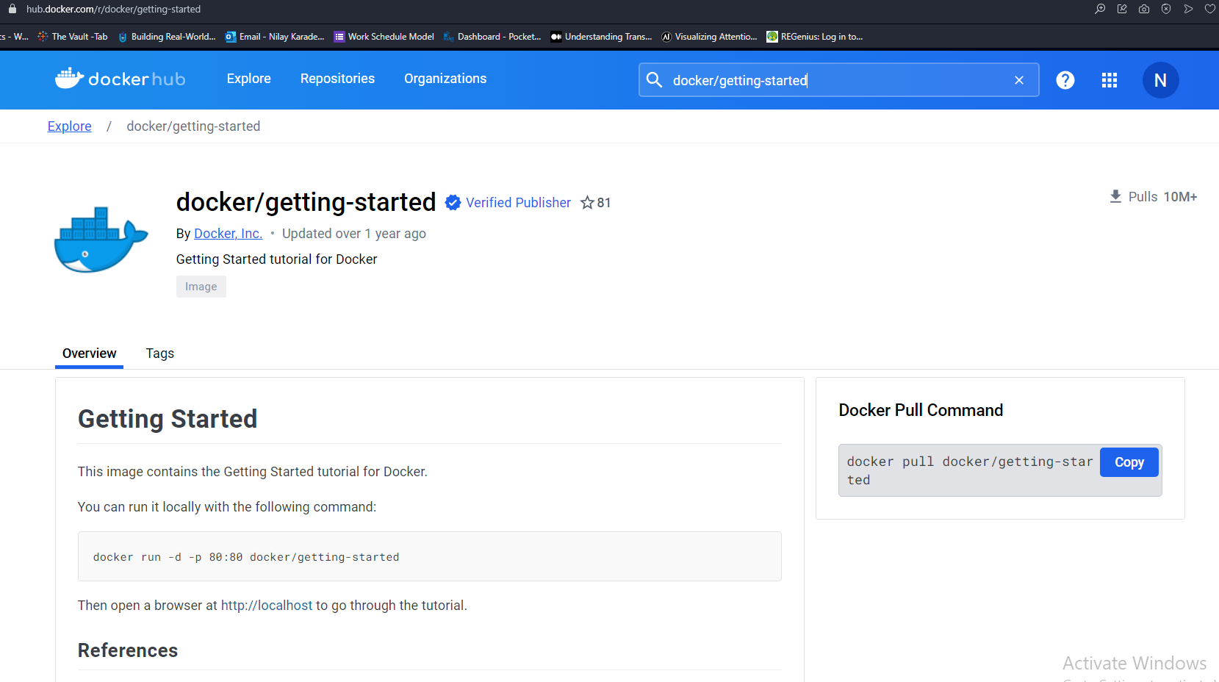

Slide 15
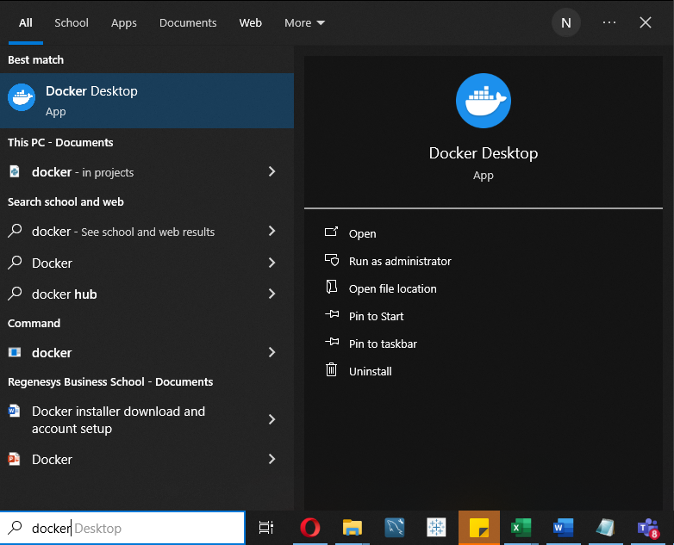
Open docker app

Slide 16
Benefits of Docker include
Portability: Docker containers can run consistently across different environments, ensuring that an application behaves the same way in development, testing, and production.
Isolation: Containers are isolated from each other and from the host system, minimizing conflicts and dependencies.
Resource Efficiency: Containers are lightweight and share the host OS kernel, which reduces resource overhead and allows for efficient use of system resources.
Rapid Deployment: Docker containers can be created and deployed quickly, making it easier to scale applications as needed.
Version Control: Docker images are versioned, making it easy to roll back to previous versions of an application.

Slide 17
docker build
Purpose: Builds a Docker image from a specified Dockerfile.
Syntax:
docker build -t <image_name>:<tag> <path_to_Dockerfile_directory>
Explanation:
-t: Specifies the name and optionally a tag to the Docker image.
<image_name>: The name you want to give to your Docker image.
<tag>: A version or label for the image.
<path_to_Dockerfile_directory>: The path to the directory containing the Dockerfile.
Example
docker build -t myapp:latest .
This command builds an image named myapp with the latest tag using the Dockerfile in the current directory (.).

Slide 18
docker push
Purpose: Pushes a Docker image to a specified container registry (e.g., Docker Hub).
Syntax:
docker push <image_name>:<tag>
Explanation:
<image_name>: The name of the Docker image.
<tag>: The version or label of the image.
Example:
docker push myapp:latest
This command pushes the locally built Docker image named myapp with the latest tag to a container registry.

Slide 19
Docker commands
docker run:
This command is used to create and start a new container based on a specified image.
Example: docker run -d -p 8080:8080 MyAppDocker
MyAppDocker container in detached mode, mapping port 8080 on the host to port 80 in the container.
docker ps:
Use this command to list running containers. It provides information like container IDs, names, and status.
Example: docker ps
lists all running containers.

Slide 20
Docker commands
docker pull:
This command fetches a Docker image from a container registry like Docker Hub.
Example: docker pull nginx
fetches the Nginx image from Docker Hub.
docker stop:
This command stops a running container by specifying its container ID or name.
Example: docker stop my-container
stops a container named "my-container."

Slide 21
Docker commands
docker images:
Use docker images to list all available Docker images on your local machine.
Example: docker images lists all locally available images.
docker rm:
Use docker rm to remove one or more containers by specifying their IDs or names.
Example: docker rm my-container removes a container named "my-container."

Slide 22
Docker commands
For addiotional docker commands visit https://docs.docker.com/engine/reference/run/ and check left side-bar menu

Slide 23
Dockerfile
# Use an official Python runtime as a parent image
FROM python:3.9-slim
# Set the working directory to /app
WORKDIR /app
# Copy the current directory contents into the container at /app
COPY . /app
# Install any needed packages specified in requirements.txt
RUN pip install --trusted-host pypi.python.org -r requirements.txt
# Make port 80 available to the world outside this container
EXPOSE 80
# Define environment variable
ENV NAME World
# Run app.py when the container launches
CMD ["python", "app.py"]

Slide 24
Dockerfile
FROM python:3.9-slim: This sets the base image to the official Python 3.9 image, which is a lightweight version of Python.
WORKDIR /app: This sets the working directory within the container to /app, where your application code will be placed.
COPY . /app: This copies the contents of the current directory (including your Flask application code) into the /app directory in the container.
RUN pip install --trusted-host pypi.python.org -r requirements.txt: This installs any required Python packages specified in your requirements.txt file. You should have a requirements.txt file with your application's dependencies in the same directory as the Dockerfile.
EXPOSE 80: This exposes port 80 on the container to allow external access to your Flask application. You can change the port number as needed.
CMD ["python", "app.py"]: This specifies the command to run when the container starts. It runs your Flask application using Python with app.py as the entry point.

Slide 25
Dockerfile
In a Dockerfile, the FROM, WORKDIR, RUN and CMD commands are used to define and configure the base image and specify how to build a new image layer.

Slide 26
Dockerfile
FROM:
The FROM command is the first instruction in a Dockerfile, and it specifies the base image from which you want to build your custom image.
It sets the foundation for your image and determines the starting point of your container.
For example, you can use an official Docker image like ubuntu, alpine, or a language-specific image like python:3.8 as your base image.

Slide 27
WORKDIR:
The WORKDIR command is used to set the working directory for any subsequent RUN, CMD, ENTRYPOINT, COPY, and ADD instructions in the Dockerfile.
It changes the current directory within the container, which can make it easier to manage files and execute commands.
You can use both absolute and relative paths as arguments to WORKDIR.

Slide 28
RUN:
The RUN command is used to execute a command or a script within the container during the image build process.
It allows you to install packages, update software, and make other changes to the container's file system.
Each RUN instruction creates a new image layer, which means that changes made in one RUN command won't persist into subsequent layers unless explicitly saved to a file.
Example:
RUN pip install -r requirements.txt
RUN pip install --trusted-host pypi.python.org -r requirements.txt
RUN apt-get update && apt-get install -y some-package

Slide 29
CMD
In a Dockerfile, the CMD instruction is used to specify the default command to run when a container based on the image is started.
It defines what executable should be run and any arguments that should be passed to it.
Each Dockerfile should have only one CMD instruction, although it can be overridden when starting the container.
Example: CMD ["python", "app.py"]

Slide 30
Summary
Why Docker ?
Dependency issues
Virtual machine
What is Docker ?
Docker installation
Docker commands
Docker image
Docker container
Docker hub
Docker file

